Slide 1
Introduction to Laravel Web-Framework

Slide 2
Meet Laravel
Laravel is a powerful PHP framework, designed for developers who need a simple and elegant toolkit to create full-featured web applications.
Laravel is an open-source PHP framework, which is easy to understand. It follows a model-view-controller (MVC) architectural pattern.

Slide 3
What is a Framework?
A framework is a structure that you can build software on. It serves as a foundation, so you're not starting entirely from scratch. Frameworks are typically associated with a specific programming language.
Using frameworks saves time and reduces the risk of errors. You don't need to write everything from the ground up, so there's less chance of introducing errors.
Frameworks can be used for developing websites, mobile applications, data science, and more. Here are some of the more popular frameworks:
Web application frameworks -> AngularJS, Django, Express, Rails, Laravel, VueJs
Mobile development frameworks -> Flutter, Xamarin, Ionic

Slide 4
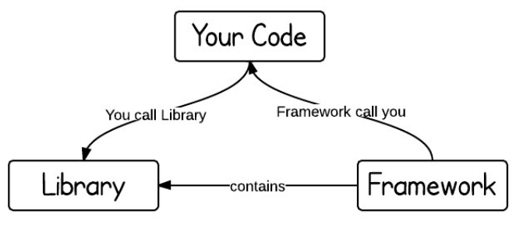
Libraries vs. frameworks
The key difference between a library and a framework is "Inversion of Control". When you call a method from a library, you are in control. But with a framework, the control is inverted: the framework calls you.

Slide 5
Model-View-Controller (MVC) Architectural Pattern:
The Model-View-Controller (MVC) is an architectural pattern that separates an application into three main logical components: the model, the view, and the controller. Each of these components are built to handle specific development aspects of an application.
MVC is one of the most frequently used industry-standard web development framework to create scalable and extensible projects.

Slide 6
View
The View component is used for all the UI logic of the application.
Model
The Model component corresponds to all the data-related logic that the user works with. This can represent either the data that is being transferred between the View and Controller components or any other business logic-related data.
Controller
Controllers act as an interface between Model and View components to process all the business logic and incoming requests, manipulate data using the Model component and interact with the Views to render the final output.
Notes:
Model
For example, a Customer object will retrieve the customer information from the database, manipulate it and update it data back to the database or use it to render data.
View
For example, the Customer view will include all the UI components such as text boxes, dropdowns, etc. that the final user interacts with.
Controller
For example, the Customer controller will handle all the interactions and inputs from the Customer View and update the database using the Customer Model. The same controller will be used to view the Customer data.

Slide 7
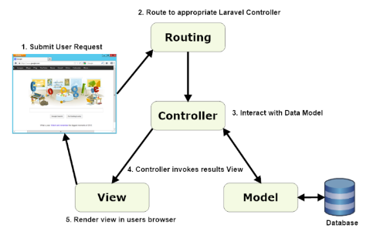
Architecture of a Laravel Application
Notes:
We will have multiple controllers in our
User will interact with the view, the view will send user request to the controller, the controller will handle the request and apply any needed validations, then will pass it to the Model.
Model is responsible for talking to the database and for saving or retrieving any data from it (logic), then the controller sends the response to the view
For best practices, the backend logic shouldn’t be in the controller, it should either be in the model or in a service middleware.

Slide 8
Features of Laravel
Eloquent ORM (object-relational mapping) - implements Active-Record
Query-Builder - helps you to build secured SQL queries
Restful Controllers - provides a way of separating the different HTTP requests (GET, PATCH, PUT, DELETE, etc..)
Blade Template engine - combines templates with a data model to produce views
Migrations - version control system for the database, update your database easier
Database seeding - provides a way to populate database tables with test data used for testing
Pagination - easy to use to advance pagination functionalities
Forms security - provides token middleware, protecting all the forms
Notes:
- Eloquent ORM: allows you to interact with your database using object-oriented techniques, rather than writing raw SQL queries.
Eloquent = model
Object-relational mapping is a programming technique that maps objects in your application to tables in a relational database. It provides a convenient way to perform database operations by abstracting away the details of the underlying database and allowing you to work with objects and their relationships.
- Query-Builder: helps us build secure queries which can help protect the database and the backend against SQL injections
- Restful Controllers: controllers that can perform CRUD operations (create, read, update, delete)
- Migrations: can create tables, modify existing ones, or even drop them. Each migration is timestamped, allowing Laravel to apply them in the correct order. This is particularly useful for collaborative environments, as it ensures that all developers working on a project can maintain a consistent database schema
- Forms Security: Laravel automatically generates a token for each active user session. This token must be included as a hidden field in every form. When a form is submitted, Laravel checks this token to ensure that the request is legitimate and not from a malicious source.

Slide 9
Let’s install laravel
Laravel uses Composer to manage its dependencies
Composer is dependency management tool for PHP, like a library full of books
Per project tool (vendor folder), not per system
Visit the following URL and download composer to install it on your system: https://getcomposer.org/download
Installation Docs : https://laravel.com/docs/4.2/installation
Install by using the command:
composer create-project laravel/laravel {directory} 4.2 --prefer-dist
Notes:
Download composer (Management tool), it downloads the dependencies (like pip)

Slide 10
Artisan
Command line interface used in Laravel is called Artisan. It includes a set of commands which assists in building a web application. These commands are incorporated from Symphony framework.
Start the Laravel service by executing the following command:
php artisan serve
Notes:
php artisan is for PHP Laravel applications, similar to how npm is for Node.js applications.

Slide 11
Eloquent Object Relational Mapping
The Eloquent ORM included with Laravel provides a beautiful, simple ActiveRecord implementation for working with your database. Each database table has a corresponding "Model" which is used to interact with that table.
To make a Model Class use the following Artisan command:
php artisan make:model User
Defining An Eloquent Model
class User extends Eloquent {
protected $table = 'my_users';
}
Notes:
“php artisan make:model User”: This command will create a new model file named User.php within the app/Models directory of your Laravel project. If the Models directory doesn't exist, it will be placed directly in the app/ directory.
“my_users” is the name of a table in our database
In your Laravel project, the database configuration settings are stored in the .env file located in the root of your project. You will need to set the appropriate values for your database connection. Here's an example of how you might configure a MySQL database:
DB_CONNECTION=mysql
DB_HOST=127.0.0.1
DB_PORT=3306
DB_DATABASE=your_database_name
DB_USERNAME=your_database_username
DB_PASSWORD=your_database_password

Slide 12
Notes:
Eloquent will also assume that each table has a primary key column named id. You may define a primaryKey property to override this convention.
Once a model is defined, you are ready to start retrieving and creating records in your table. Note that you will need to place updated_at and created_at columns on your table by default. If you do not wish to have these columns automatically maintained, set the $timestamps property on your model to false.
Notes:
“created_at” is a timestamp column which adds the time when a record was created
“updated_at” is a timestamp column which adds the time when a record was updated

Slide 13
Basic Usage
Retrieving All Models
$users = User::all();
Retrieving A Record By Primary Key
$user = User::find(1);
Retrieving A Model By Primary Key Or Throw An Exception
Sometimes you may wish to throw an exception if a model is not found, allowing you to catch the exceptions using an App::error handler and display a 404 page.
$model = User::findOrFail(1);
$model = User::where('votes', '>', 100)->firstOrFail();
Notes:
To access the records, you would write something like this: foreach ($users as $user) {
echo $user->name;
echo $user->email;
}
findOrFail(): If the user is not found, instead of returning null, the findOrFail method throws a ModelNotFoundException. Laravel automatically converts this exception into an HTTP 404 response, displaying the 404 error page.
firstOrFail(): means return only the first record found, or throw an exception if no record is found

Slide 14
Eloquent Aggregates
$count = User::where('votes', '>', 100)->count();
Insert, Update, Delete
To create a new record in the database from a model, simply create a new model instance and call the save method.
Saving A New Model
Updating A Retrieved Model
To update a model, you may retrieve it, change an attribute, and use the save method:
$user = new User;
$user->name = 'John';
$user->save();
$user = User::find(1);
$user->email = 'john@foo.com';
$user->save();

Slide 15
Using The Model Create Method
// Create a new user in the database...
$user = User::create(array('name' => 'John'));
// Retrieve the first user by the attributes, or create it if it doesn't exist...
$user = User::firstOrCreate(array('name' => 'John'));
// Retrieve the first user by the attributes, or instantiate a new instance that does not yet exist in the database
$user = User::firstOrNew(array('name' => 'John'));
Deleting An Existing Model
To delete a model, simply call the delete method on the instance:
$user = User::find(1);
$user->delete();
Notes:
firstOrNew(): returns the first user found by certain attributes, or creates an object of this user and stores it in $user variable without creating it in the database

Slide 16
Routing
Most of the routes for your application will be defined in the app/web.php file. The simplest Laravel routes consist of a URL and a Closure callback.
Basic POST Route
Basic GET Route
Route::post(‘foo/bar', function()
{
return 'Hello World';
});
Route::get('/', function()
{
return 'Hello World';
});
Notes:
Routing can be used to call certain functions, or, if we have more complex logic, call a certain controller
foo/bar means the url: domain/foo/bar

Slide 17
Route Parameters
Route::get('user/{id}', function($id)
{
return 'User '.$id;
});
Regular Expression Route Constraints
Route::get('user/{name}', function($name)
{
//
})->where('name', '[A-Za-z]+');
Notes:
Regex allows us to control the variable that will be entered in the URL
1- Client Makes a Request: When a user visits a URL in their web browser or when an API client makes a request to your Laravel application, the request is sent to a specific route. For example, if someone visits http://yourdomain.com/user/123, the request is sent to your server where Laravel is hosted.
2- Laravel's routing system processes the incoming request. It looks for a route definition that matches the URL path (user/{id}). In this case, it finds your route that expects an id parameter.
3- The function associated with the route is executed. It takes the id from the URL, concatenates it with the string 'User ', and returns this concatenated string.
4- Laravel then sends this string back to the client as the body of an HTTP response. The content type of this response is typically text/plain, indicating that the response is plain text.
5- The web browser will display the response text as it is. For example, if you navigated to http://yourdomain.com/user/123, you would see User 123 displayed in the browser window.

Slide 18
Controllers
Controllers are typically stored in the app/controllers director
Here is an example of a basic controller class:
class UserController extends BaseController {
public function showProfile($id)
{
$user = User::find($id);
return View('user.profile', array('user' => $user));
}
}

Slide 19
All controllers should extend the BaseController class. The BaseController is also stored in the app/controllers directory, and may be used as a place to put shared controller logic. The BaseController extends the framework's Controller class. Now, we can route to this controller action like so:
Route::get('user/{id}', 'UserController@showProfile');
To create the controller via the command line, execute the following command:
php artisan controller:make UserController

Slide 20
Blade templating engine
The Blade is a powerful templating engine in a Laravel framework. The blade allows to use the templating engine easily, and it makes the syntax writing very simple.
The blade templating engine provides its own structure such as conditional statements and loops.
To create a blade template, you just need to create a view file and save it with a .blade.php extension instead of .php extension.
The blade templates are stored in the /view directory.
The main advantage of using the blade template is that we can create the master template, which can be extended by other files.
Notes:
We write HTML inside the blade file

Slide 21
Displaying data
If you want to print the value of a variable, then you can do so by simply enclosing the variable within the curly brackets. Syntax :
{{$variable}};
In blade template, we do not need to write the code between <?php echo $variable; ?>. The above syntax is equivalent to <?= $variable ?>.
Ternary operator
In blade template, the syntax of ternary operator can be written as:
{{ $variable or 'default value'}}
The above syntax is equivalent to <?= isset($variable) ? $variable : 'default value' ?>

Slide 22
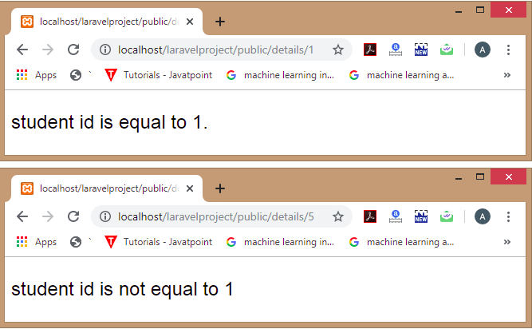
Blade Template Control Statements
Blade templating engine also provides the control statements in laravel as well as shortcuts for the control statements.
<html>
<body>
<font size='5' face='Arial'>
@if(($id)==1)
student id is equal to 1.
@else
student id is not equal to 1
@endif
</font>
</body>
</html>

Slide 23
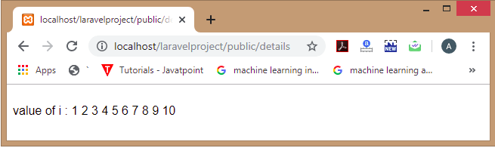
Blade Loops
The blade templating engine provides loops such as @for, @endfor, @foreach, @endforeach, @while, and @endwhile directives. These directives are used to create the php loop equivalent statements.
Add the route in the web.php file.
PostController.php
Student.blade.php
public function display()
{
return view(‘Student');
}
Route::get('/details', 'PostController@display');
value of i :
@for($i=1;$i<11;$i++)
{{$i}}
@endfor
Notes:
The route in web.php called the display method in PostController controller in PostController.php which then called the view in Student.blade.php
The rendered page is sent back as a response to /details
The file name PostController.php needs to match the class name inside it (which should be PostController class); as “'PostController” part in “Route::get('/details', 'PostController@display’);” refers to the file name in the controllers directory.

Slide 24
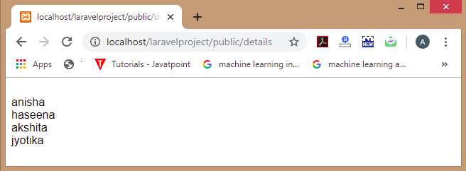
Blade Loops
Add the route in the web.php file.
Student.blade.php
PostController.php
Route::get('/details', 'PostController@display');
@foreach($students as $student)
{{$student}}<br>
@endforeach
public function display()
{
return view(‘Student', ['students'=>['anisha','haseena','akshita','jyotika']]);
}

Slide 25
Template Inheritance
Master Page Layout
Master page layout defines the common layout across all the web pages. All the web applications have the master page layout to define the common layout across all the web pages. The master page layout is available in the /views/layouts/ directory.
master.blade.php
<html>
<head>
<title> Master Page Layout </title>
</head>
<body>
<div class="container">
@yield('content')
</div>
@yield('footer')
</body>
</html>
we have used the @yield directive. The @yield is used to display the content. The @yield('content') displays the content of the 'content' while @yield('footer') displays the content of the footer.

Slide 26
Extending Master Layout
Now, we are going to extend the above master layout in contact.blade.php file as shown below:
Contact.blade.php
we use the @extends directive. The '@extends' directive is used to inherit the blade layout in contact.blade.php file. The '@section('content')' defines the section of the content.
@extends('layout.master')
@section('content')
<h1>Contact Page </h1>
@stop

Slide 27
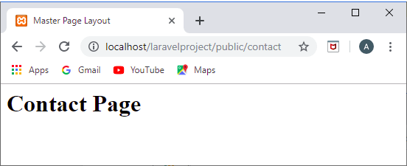
Add the following route in web.php file.
Route::get('/contact', function () {
return view(‘Contact');
});
Output:
Notes:
The anonymous function is acting similarly to a controller method here since the controller's job is to handle the logic for HTTP requests and return responses. An anonymous function associated with a route can do the same thing: it receives the request and returns a response, which in this case, is a rendered view.

Slide 28
Let's see another example of blade template.
We create a new file named as "post.blade.php" file.
post.blade.php
This code defines the section of the content in which we are displaying the values of id, password and name respectively.
@extends('layout.master')
@section('content')
<h1>Post Page:</h1>
<h2>id is :{{$id}}<br> Password is :{{$password}}<br>Name is : {{$name}}</h2>
@stop

Slide 29
Now, we create a controller named as 'PostController.php'.
PostController.php
<?php
namespace App\Http\Controllers;
use Illuminate\Http\Request;
class PostController extends Controller
{
public function show_post($id,$password,$name)
{
return view('post',compact('id','password','name'));
}}
In PostController.php file, we defined a new function named as show_post() which passes the data to the post.blade.php file.
Notes:
NOTE 1:
The namespace is essential for the Laravel framework to locate and use the controller class correctly. Without the correct namespace, Laravel's routing system wouldn't be able to resolve the path to the controller when a route is accessed.
NOTE 2:
The use statement for Illuminate\Http\Request is not strictly necessary here since we're not type-hinting the Request object in your methods. However, it's a common practice to include it at the top of the controller as it's frequently used for accessing request data within controller actions. If we plan to use the Request class later or in other methods within the controller, we should keep the use statement. Otherwise, we could remove it if it's not being used at all, but this is generally not a good practice as it is a standard part of a Laravel controller's structure.
NOTE 3:
Request is used to access data in a similar way to _REQUEST in vanilla PHP. Taking the above example and implementing Request: <?php
namespace App\Http\Controllers;
use Illuminate\Http\Request;
class PostController extends Controller
{
public function show_post(Request $request)
{
$id = $request->query('id');
$password = $request->query('password');
$name = $request->query('name');
return view('post', compact('id', 'password', 'name'));
}
}
Note 4:
For a POST request, the variables are passed through the request body, usually from a form or API client. Inside your controller method, you can access these variables using the Request object. For example:
Route::post('/submit-form', 'FormController@submit’);
And in the FormController class in FormController.php:
public function submit(Request $request)
{
$var1 = $request->input('var1');
$var2 = $request->input('var2');
// Process the variables...
}
Where var1 and var2 are the names of the fields from your form or API request.
In Laravel, $request->query() is used to access query string parameters (from the URL), typically for GET requests. For POST requests, where data is sent in the request body (such as form submissions), you would use $request->input() to access the variables.
$request->query('param') retrieves data from the query string.
$request->input('param') retrieves data from the request body in POST requests.
NOTE 5:
The compact function in PHP is used to create an array from existing variables. In the context of Laravel, when you pass data to a view, compact is used to create an associative array that contains keys and values based on the names and values of the variables you pass to it.
For example, compact('id', 'password', 'name') will create the following array:
[
'id' => $id,
'password' => $password,
'name' => $name,
]
If you don't use compact, you would need to manually construct an associative array with keys and values to pass to the view:
return view('post', ['id' => $id, 'password' => $password, 'name' => $name]);
NOTE 6:
The compact function in PHP automatically looks for variables with the names given as string arguments and maps their values to the corresponding keys in the array it creates. So when you call compact('id'), it takes the $id variable that exists in the scope where compact is called and creates an array with a key 'id' that has the value of $id. The function does this for each string argument you pass to it, matching the string to a variable with the same name in the current scope.

Slide 30
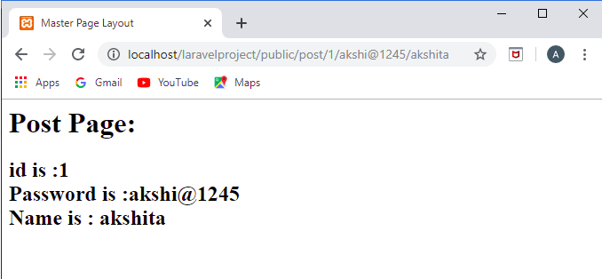
Lastly, we define a route in web.php file.
web.php
Route::get('/post/{id}/{password}/{name}','PostController@show_post');
Output:

Slide 31
Till now, we have seen that both the post.blade.php and contact.blade.php files are extending the master layout file. This is the main advantage of a master layout that every file can extend the layout of the master file and add their own functionalities.
Now, let’s take a look at the use of @parent directive, it is to display the content of the section defined in the master layout.
Let's understand through an example.
First, we create a master file.
master.blade.php
<html>
<head>
<title> Master Page Layout </title>
</head>
<body>
<div class="container">
@yield('content’)
</div>
@section('footer')
This is footer
@show
</body>
</html>

Slide 32
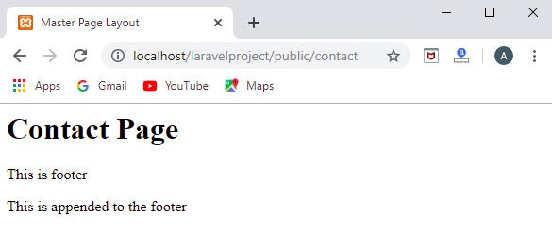
Now, we create the contact.blade.php in which we extend the above master.blade.php file.
@parent directive adds the paragraph content to the footer section.
@extends('layout.master')
@section('content')
<h1>Contact Page</h1>
@stop
@section('footer')
@parent
<p>this is appended to the footer</p>
@stop
Notes:
@section(‘content’) will also be affected by class=“container” styling that appeared in the parent

Slide 33
Notes:
@endsection and @stop are the same and indicate the end of a section.
@endsection directive just tells the blade engine where the section actually ends. And to show that section you need to use the @yield directive. If you don't yield that section blade won't show it after rendering the view.
@show is equivalent to
@stop
@yield('sectionname')
Notes:
if @show was replaced by @stop in the master, which means that @yield was not written, then “This is a footer” would not be displayed. In fact, inheriting something that doesn’t contain @yield would be pointless since nothing in that inherited part would be rendered even at the child’s view.

Slide 34
Notes:
@yield('SectionName')
Can be provided with a default string but no HTML! @yield('SectionName','Default String')
The default string will be shown in the sub-blade-template when no @section('SectionName') .. @endsection is provided (in the child file).
@section('SectionName') ……default HTML content of section……. @show
Can be provided with a default HTML code.
The default HTML code will be shown in the sub-blade-template when no @section('SectionName') is provided (in the child file).
To show the default string and append to it in the child file you should use @section('SectionName')@parent ……appended string ….. @endsection

Slide 35
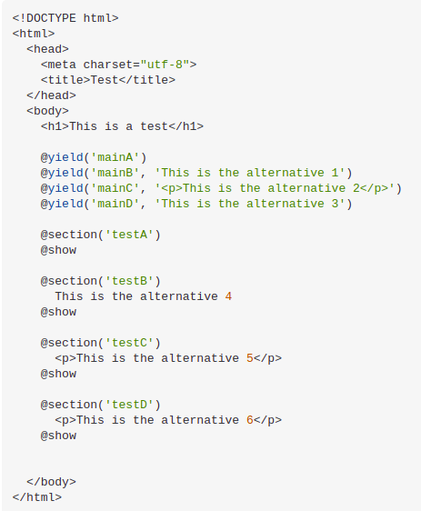
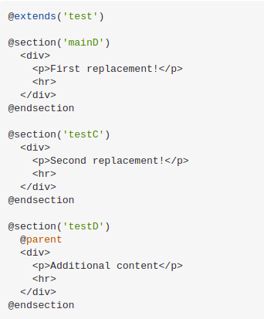
test.blade.php
testA.blade.php

Slide 36
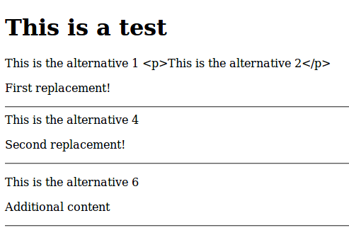
Output

Slide 37
Thank You

